Slide 1
Simple lockdown model
Susceptible
S
α
Infected
I
β
Recovered
R
Scenario:
1. Before the lockdown parameters α and β are growing linearly:
(each time step)
α = α +C₁ and β = β +C₂ , C₁ > C₂
2. The lockdown occurs only once when I > C₃ and lasts until R ⩽ C₃ :
During this period α ≈ 0 but β is still growing
3. After the lockdown (when R > C₃) α may be changed for many reasons:
α = α +C₄ ,C₄ >C₂

Slide 2
Short and Tight Lockdown
Before:
α = α +C₁
β = β + C₂
Lockdown:
α ≈ 0
β = β + C₂
After:
α = α +C₄
β = β + C₂
Initial α and β is zero
C₁ = 0.02
C₂ = 0.005
C₃ = 0.205
C₄ = 0.12

Slide 3
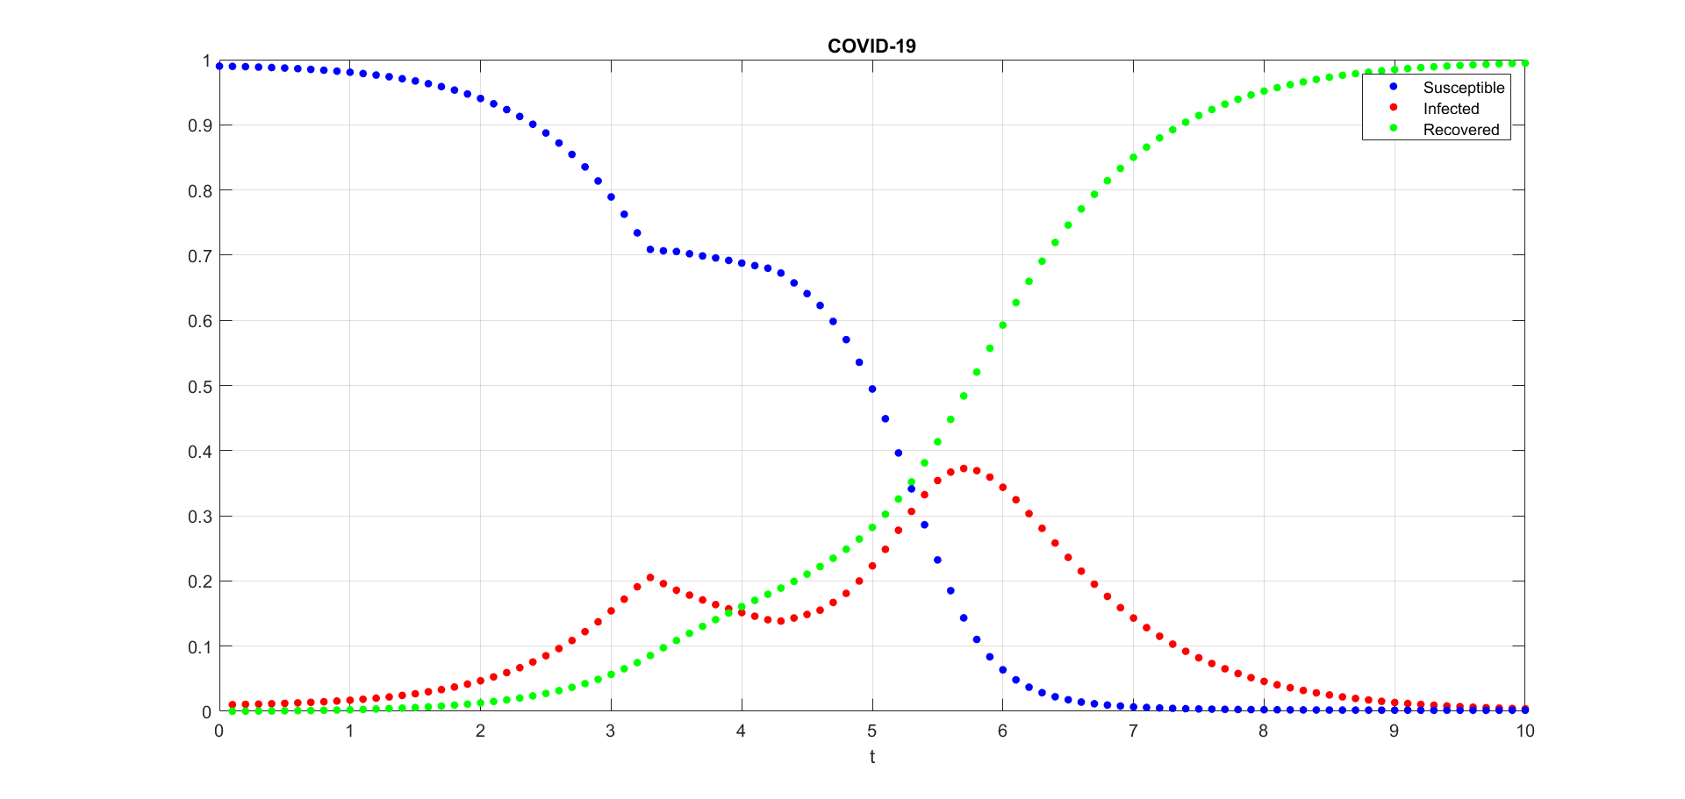
End of lockdown
Start of lockdown
As we can see, even this simple lockdown model shows the general trend for COVID-19. But, of course, it cannot give us the full understanding of the disease spread.

